Slide 1


Slide 2
Introduction: Software is Complex
Complex ≠ complicated
Complex = composed of many simple parts
related to one another
Complicated = not well understood, or explained

Slide 3




Complexity Example:
Scheduling Fence Construction Tasks
Setting posts
[ 3 time units ]
Cutting wood
[ 2 time units ]
Nailing
[ 2 time units for unpainted;
3 time units otherwise ]
Painting
[ 5 time units for uncut wood;
4 time units otherwise ]
Setting posts < Nailing, Painting
Cutting < Nailing
…shortest possible completion time = ?
[ ⇒ “simple” problem, but hard to solve without a pen and paper ]
Notes:
SOURCE: Goodaire & Parmenter, Discrete Mathematics with Graph Theory, Third Edition, Pearson Prentice Hall, 2006. [ Section 11.5, p. 361 ]

Slide 4

More Complexity
Suppose today is Tuesday, November 29
What day will be on January 3?
[ To answer, we need to bring the day names and the day numbers into coordination, and for that we may need again a pen and paper ]
Notes:
SOURCE: Hutchins, Cognition in the Wild, The MIT Press, 1995. [ p. 315 ]

Slide 5
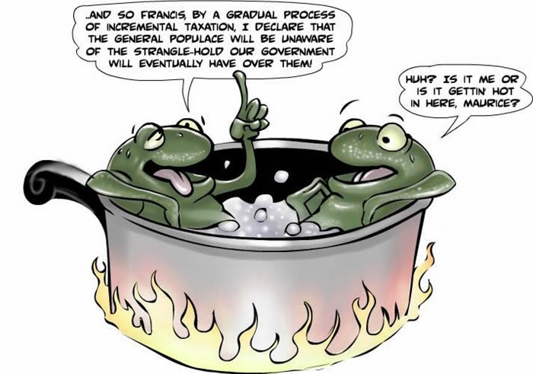
The Frog in Boiling Water
Small problems tolerate complacency—lack of immediate penalty leads to inaction
Negative feedback accumulates subtly and by the time it becomes painful, the problem is too big to address
Frog in gradually heated water analogy:
  The problem with little things is that none of them is big enough to scare you into action, but they keep creeping up and by the time you get alarmed the problem is too difficult to handle
  Consequently, “design smells” accumulate, “technical debt” grows, and the result is “software rot”
https://en.wikipedia.org/wiki/Design_smell
https://en.wikipedia.org/wiki/Technical_debt
https://en.wikipedia.org/wiki/Software_rot
Notes:
https://en.wikipedia.org/wiki/Boiling_frog
http://tealandco.com/the-frog-in-boiling-water-the-myth-and-the-metaphor/
https://www.theatlantic.com/technology/archive/2006/09/the-boiled-frog-myth-stop-the-lying-now/7446/
https://medium.com/psychology-secrets-for-marketing/the-boiling-frog-4ef1d66c9b35

Slide 6

The Role of Software Engg. (1)
A bridge from customer needs to programming implementation
Customer
Software Engineering
Programmer
First law of software engineering
Software engineer is willing to learn the problem domain
(problem cannot be solved without understanding it first)
Notes:
"You cannot solve it, unless you understand it."

Slide 7
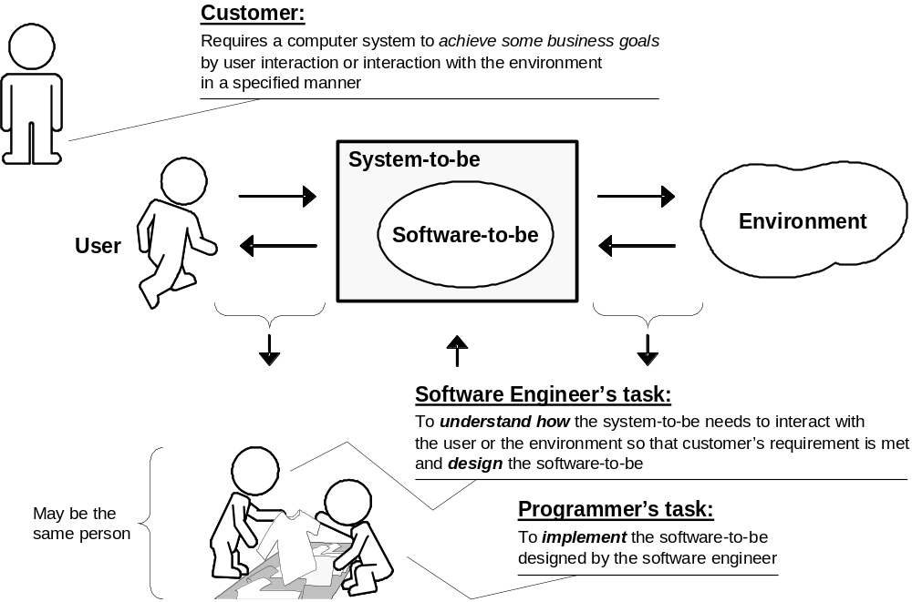
The Role of Software Engg. (2)

Slide 8
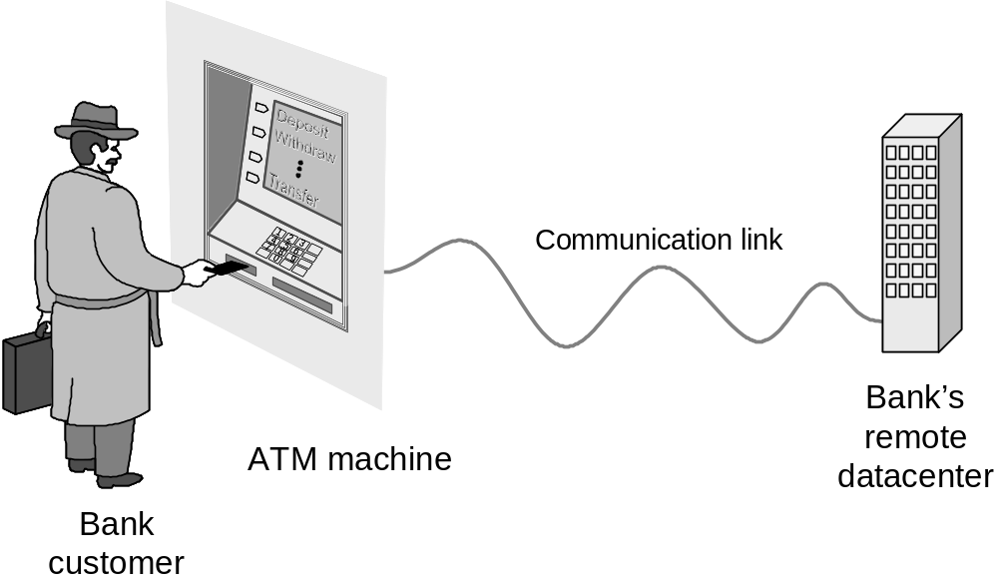
Example: ATM Machine
Understanding the money-machine problem:

Slide 9
Problem-solving Strategy
Divide-and-conquer:
Identify logical parts of the system that each solves a part of the problem
Easiest done with the help of a domain expert who already knows the steps in the process (“how it is currently done”)
Result:
A Model of the Problem Domain
(or “domain model”)

Slide 10
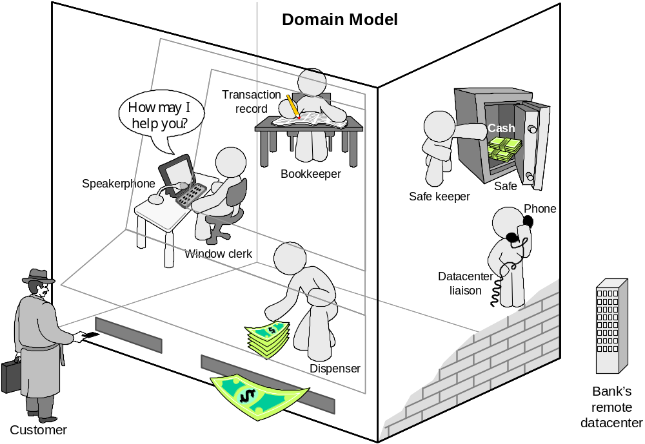
How ATM Machine Might Work
Notes:
https://gizmodo.com/apparently-a-way-of-hacking-atms-called-jackpotting-has-1822494175/amp
Man gets stuck in ATM and slips 'help me' notes through receipt slot
By Gisela Crespo, CNN | Fri July 14, 2017
http://www.cnn.com/2017/07/13/us/repairman-stuck-in-atm-room-trnd/index.html
Repairman gets stuck in ATM | Fri July 14, 2017
A repairman changing out the lock of an ATM got stuck inside the room housing the machine and was later freed after slipping notes asking for help through the cash dispenser's receipt slot. Footage from affiliate.
http://www.cnn.com/videos/us/2017/07/13/repairman-stuck-atm-orig.cnn

Slide 11
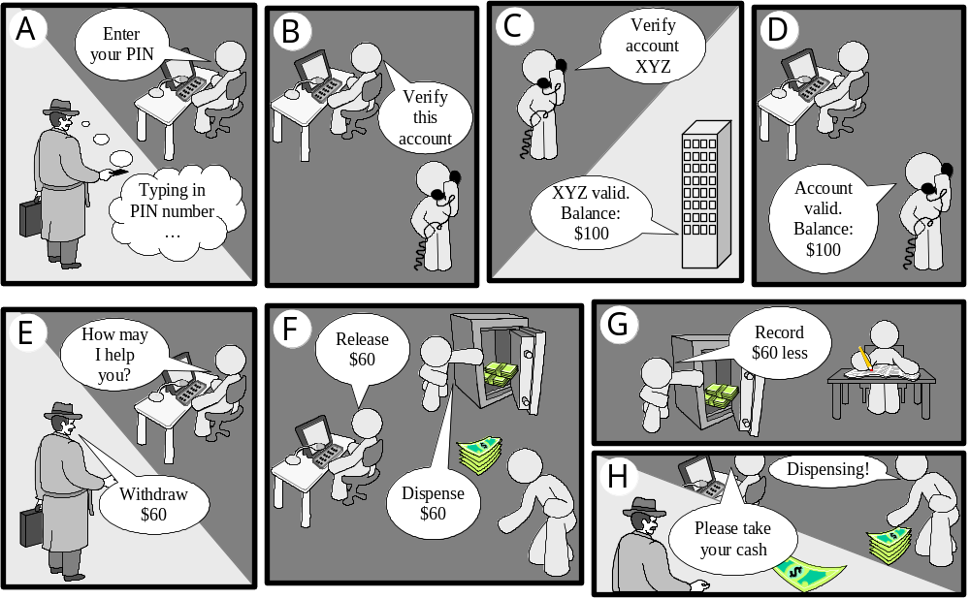
Cartoon Strip: How ATM Machine Works

Slide 12
Software Engineering Blueprints
Specifying software problems and solutions is like cartoon strip writing
Unfortunately, most of us are not artists, so we will use something less exciting:
UML symbols
However …

Slide 13
Second Law of Software Engineering
Software should be written for people first
  ( Computers run software, but hardware quickly becomes outdated )
  Useful + good software lives long
  To nurture software, people must be able to understand it

Slide 14
Software Development Methods
Method = work strategy
    The Feynman Problem-Solving Algorithm:
    (i) Write down the problem (ii) think very hard, and
    (iii) write down the answer.
Waterfall
    Unidirectional, finish this step before moving to the next
Iterative + Incremental
    Develop increment of functionality, repeat in a feedback loop
Agile
    Continuous user feedback essential; feedback loops on several levels of granularity

Slide 15
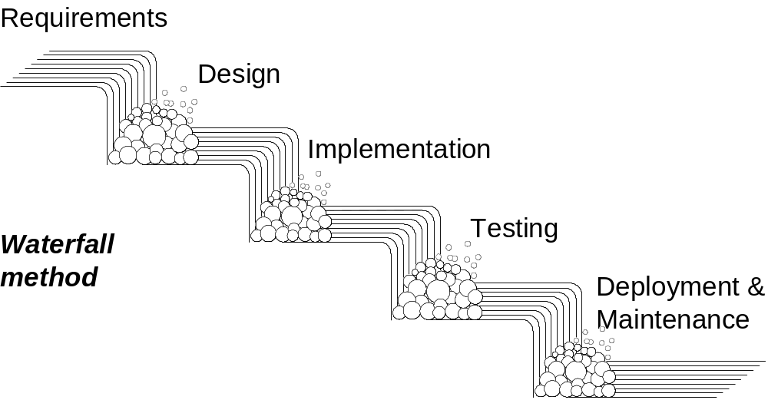
Waterfall Method
Each activity confined to its “phase”.
Unidirectional, no way back;
finish this phase before moving to the next

Slide 16
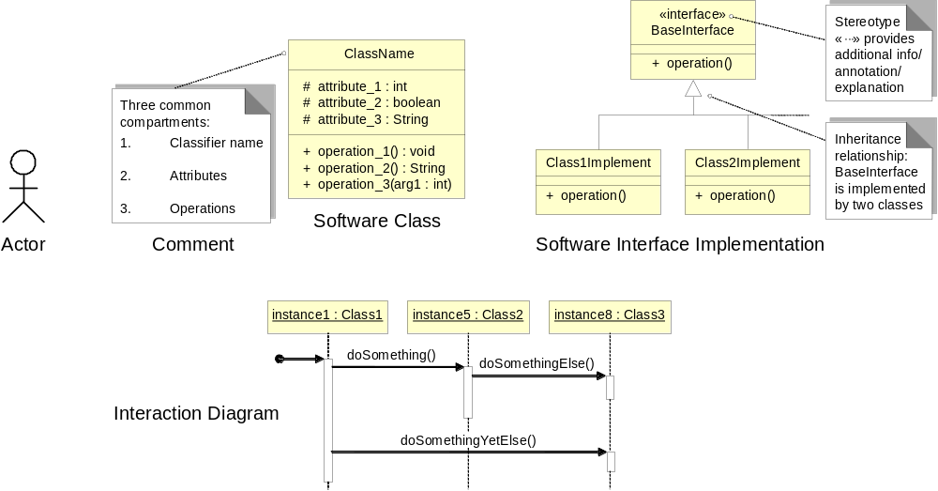
UML – Language of Symbols
UML = Unified Modeling Language
Online information:
http://www.uml.org
Notes:
The key advantage of UML is that it is a worldwide standard, widely used, with many reference publications.

Slide 17
How Much Diagramming?
Use informal, ad-hoc, hand-drawn, scruffy diagrams during early stages and within the development team
  Hand-drawing forces economizing and leads to low emotional investment
    Economizing focuses on the essential, most important considerations
      Prioritize substance over the form
    Not being invested facilitates critique and suggested modifications
  Always take snapshot to preserve records for future
Use standardized, neat, computer-generated diagrams when consensus reached and designs have “stabilized”
  Standards like UML facilitate communication with broad range of stakeholders
  But, invest effort to make neat and polished diagrams only when there is an agreement about the design, so this effort is worth doing
    Invest in the form, only when the substance is worth such an investment

Slide 18
Understanding the Problem Domain
System to be developed
Actors
  Agents external to the system that interact with it
Concepts/ Objects
  Agents working inside the system to make it function
Use Cases
  Scenarios for using the system

Slide 19
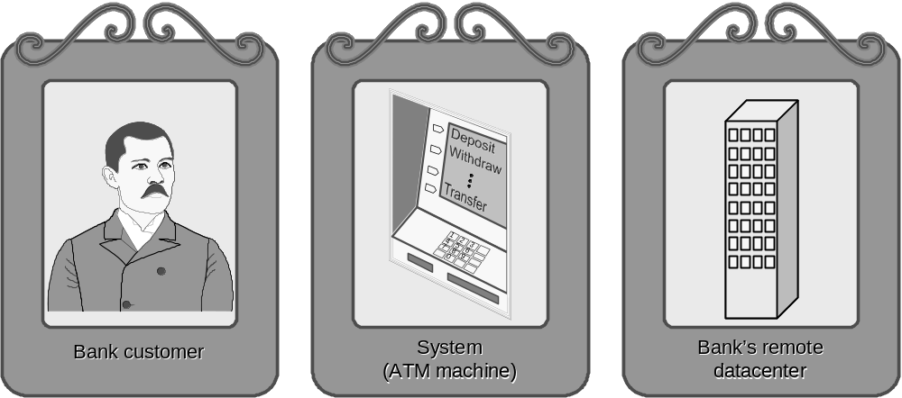
ATM: Gallery of Players
Actors
(Easy to identify because they are visible!)

Slide 20
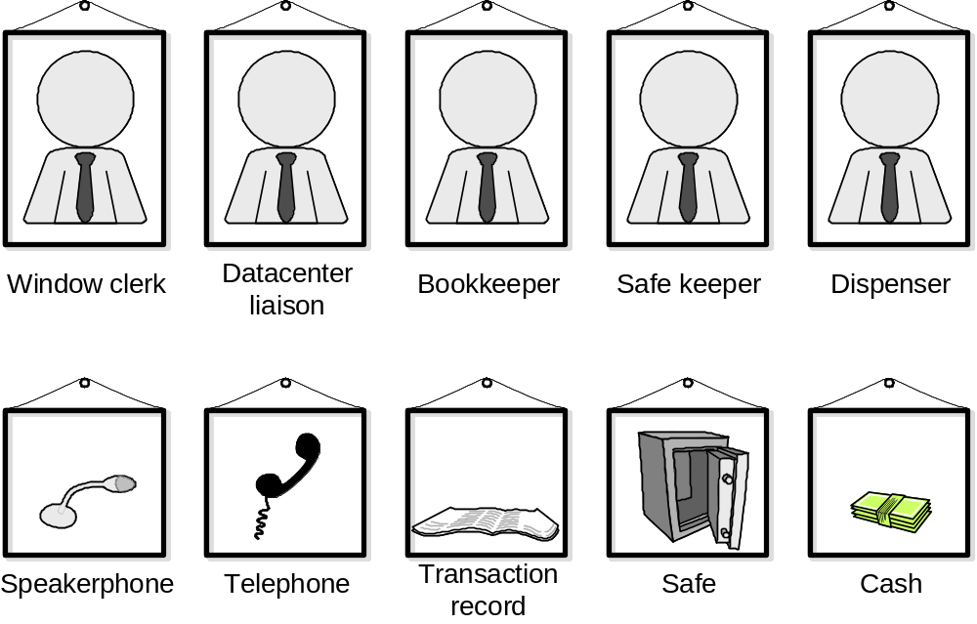
Gallery of Workers + Tools
Concepts
(Hard to identify because they are invisible/imaginary!)

Slide 21
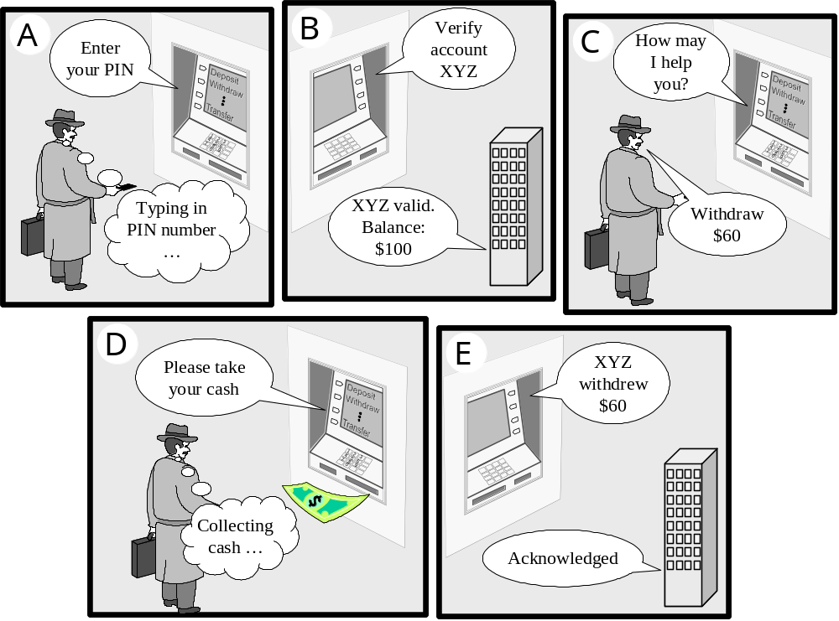
Use Case: Withdraw Cash

Slide 22
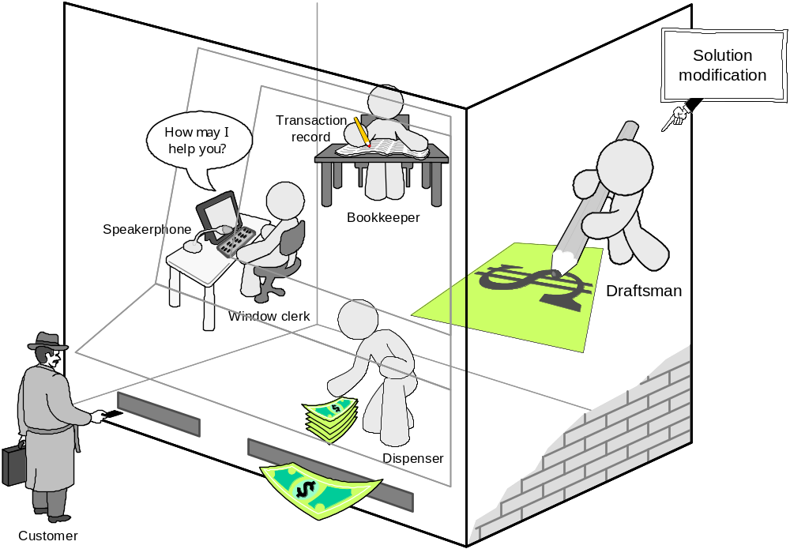
How ATM Machine Works (2)
Domain Model (2)
Alternative solution

Slide 23
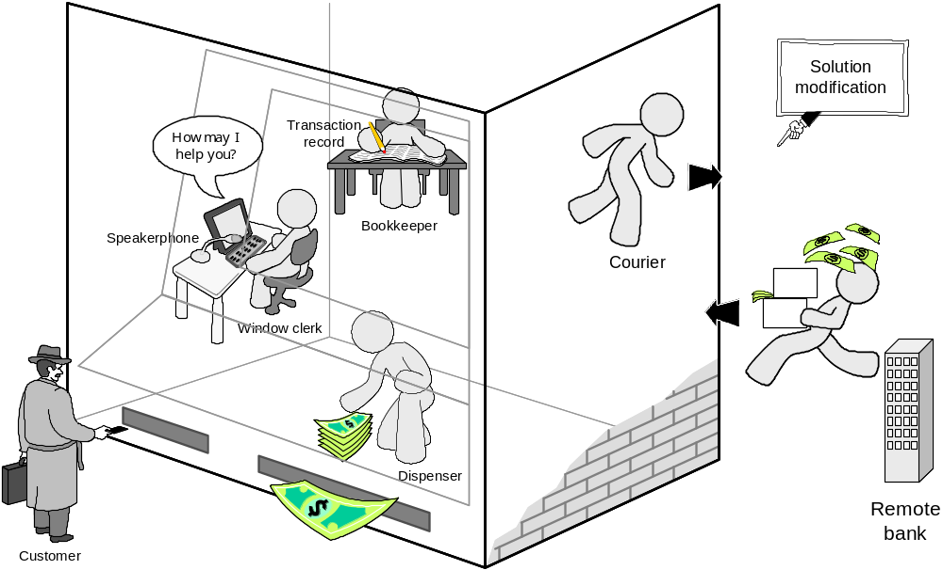
How ATM Machine Works (3)
Domain Model (3)
Alternative solution
Which solution is the best or even feasible?

Slide 24
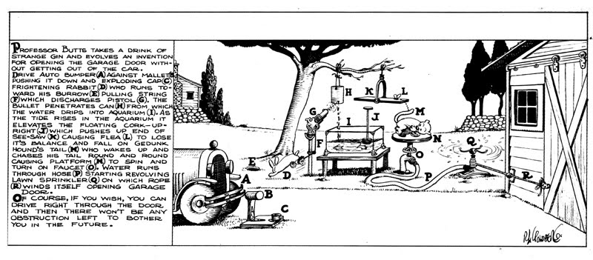
Rube Goldberg Design
Garage door opener

Slide 25
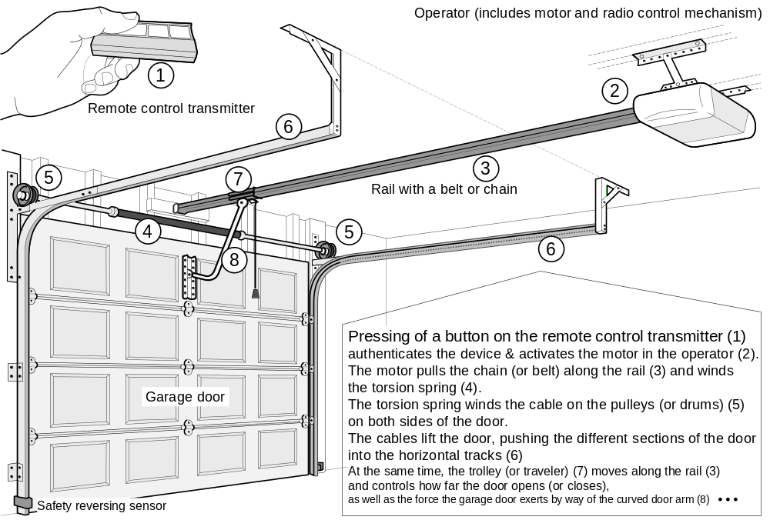
Actual Design

Slide 26
Feasibility & Quality of Designs
Judging feasibility or quality of a design requires great deal of domain knowledge
(and commonsense knowledge!)

Slide 27
Software Measurement
What to measure?
  Project (developer’s work),
  for budgeting and scheduling
  Product,
  for quality assessment

Slide 28
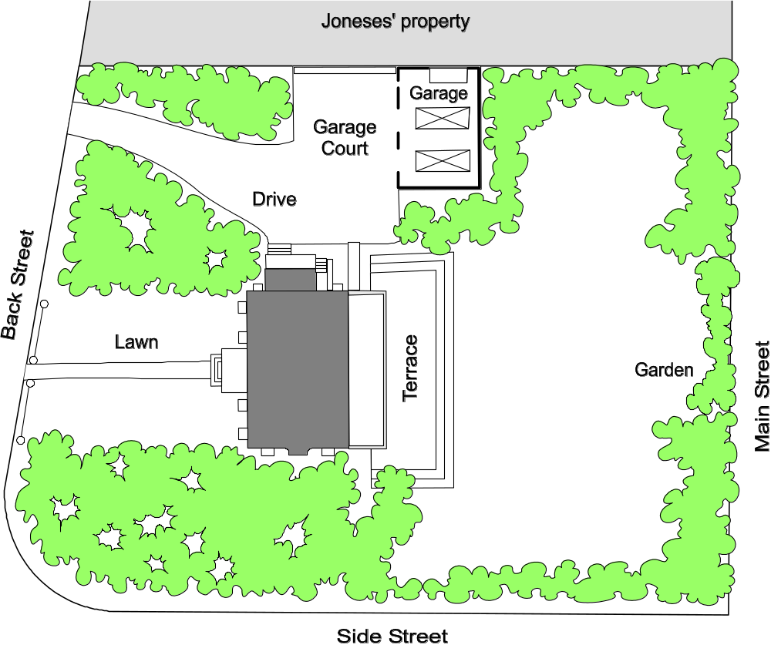
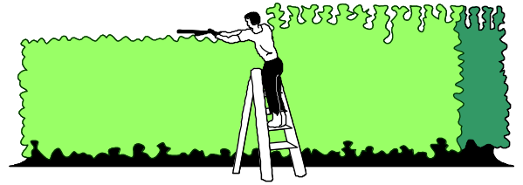
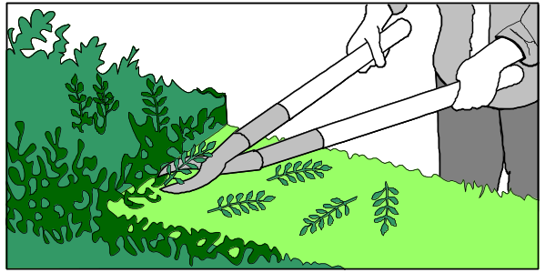
Formal hedge pruning

Slide 29
Work Estimation Strategy
Make initial guess for a little part of the work
Do a little work to find out how fast you can go
Make correction on your initial estimate
Repeat until no corrections are needed
or work is completed

Slide 30
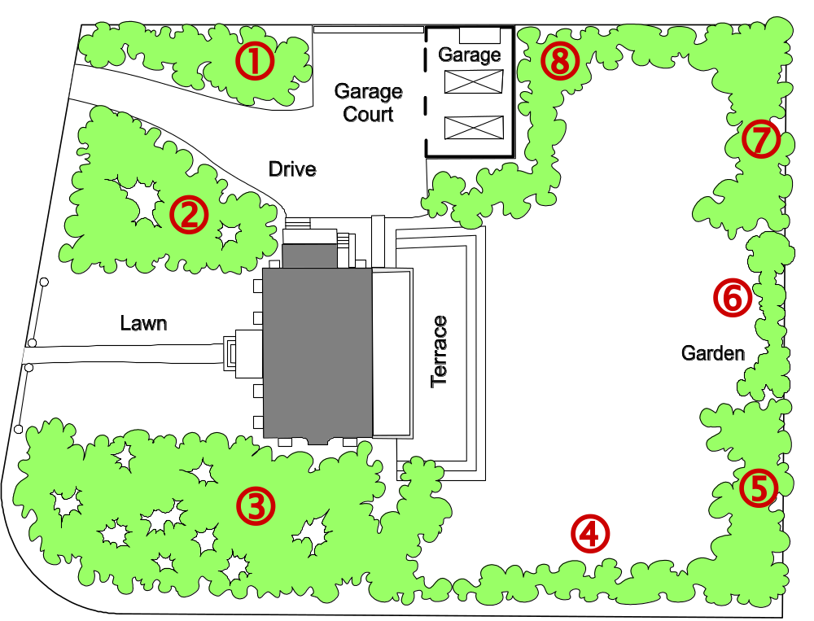
Sizing the Problem (1)
Step 1: Divide the problem into small & similar parts
Step 2:
Estimate relative sizes of all parts
Size(  ) = 4
Size(  ) = 7
Size(  ) = 10
Size(  ) = 3
Size(  ) = 4
Size( □ ) = 2
Size(  ) = 4
Size(  ) = 7
Notes:
Important that the parts are small and similar: Small objects can be easier sized; Similar objects can be easier compared with one another (it is easier to estimate relative sizes of objects two or three times different in size than object different 37 versus 43 times in size).

Slide 31
Sizing the Problem (2)
Step 3: Estimate the size of the total work
Total size = Σ points-for-section i (i = 1..N)
Step 4: Estimate speed of work (velocity)
Step 5: Estimate the work duration
Travel duration =
Path size
Travel velocity

Slide 32
Sizing the Problem (3)
Assumptions:
  Relative size estimates are accurate
    That’s why parts should be small & similar-size!
Advantages:
  Velocity estimate may need to be adjusted (based on observed progress)
  However, the total duration can be recomputed quickly
    Provided that the relative size estimates of parts are accurate
    —accuracy easier achieved if the parts are small and similar-size
Unfortunately:
Unlike hedges, software is mostly invisible and
does not exist when project is started
➔ The initial estimate hugely depends on experience and imagination

Slide 33
Exponential Cost of Estimation
100%
Estimation accuracy
Estimation cost
Improving accuracy of estimation beyond a certain point requires huge cost and effort (known as the law of diminishing returns)
In the beginning of the curve, a modest effort investment yields huge gains in accuracy

Slide 34
Estimation Error Over Time
Estimation
error
Waterfall Method
Requirements
Design
Implementation
Start
Completion
Time
Waterfall method cone of uncertainty starts high and gradually converges to zero as the project approaches completion.
Notes:
Barry Boehm, Software Engineering Economics, Prentice-Hall, 1991.

Slide 35
Estimation Error Over Time
Estimation
error
Agile Method
Leaps in estimation accuracy caused by insight about the overall project, gained through completion of parts of work
Requirements
Design
Implementation
Requirements
Design
Implementation
Start
Requirements
Design
Implementation
Project
Completion
Time
Part 1 completion
Part 2 completion
Agile method cone of uncertainty starts high and in leaps converges to zero as the project approaches completion.

Slide 36
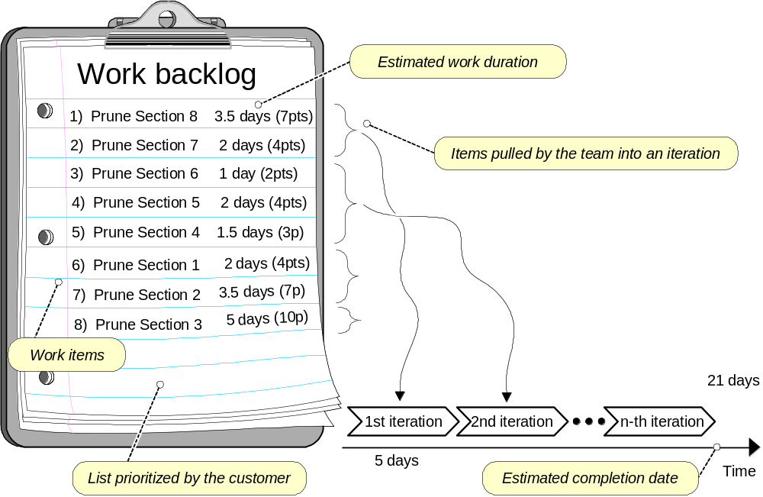
Agile Project Effort Estimation

Slide 37
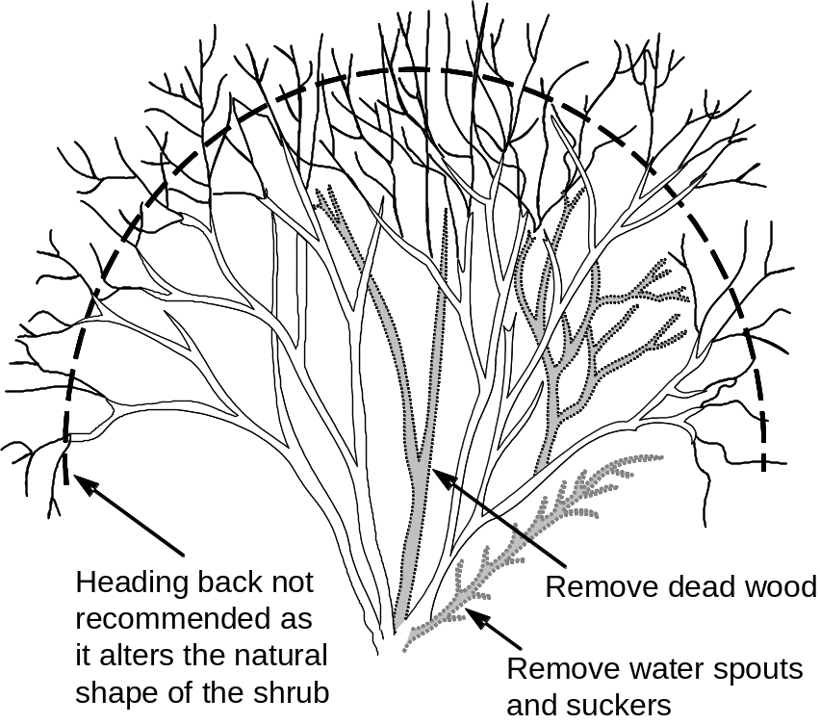
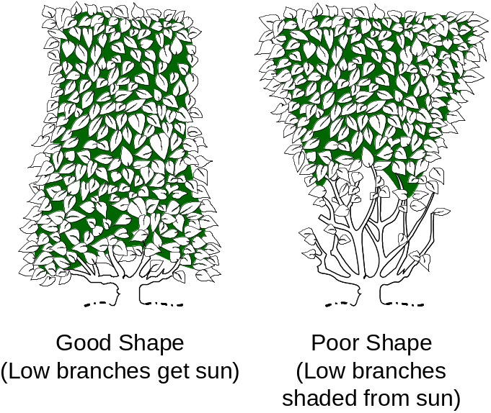
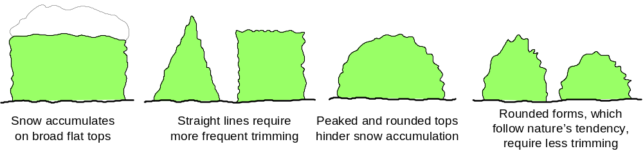
Measuring Quality of Work

Slide 38
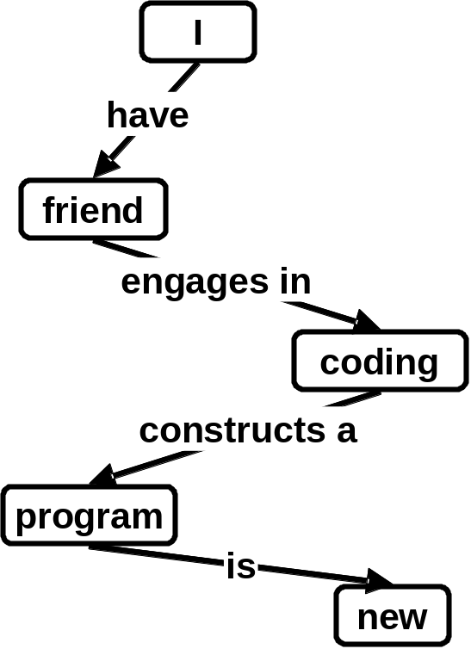
Concept Maps
Useful tool for problem domain description
SENTENCE: “My friend is coding a new program”
translated into propositions
Proposition | Concept | Relation | Concept
1. | I | have | friend
2. | friend | engages in | coding
3. | coding | constructs a | program
4. | program | is | new
Search the Web for Concept Maps

Slide 39
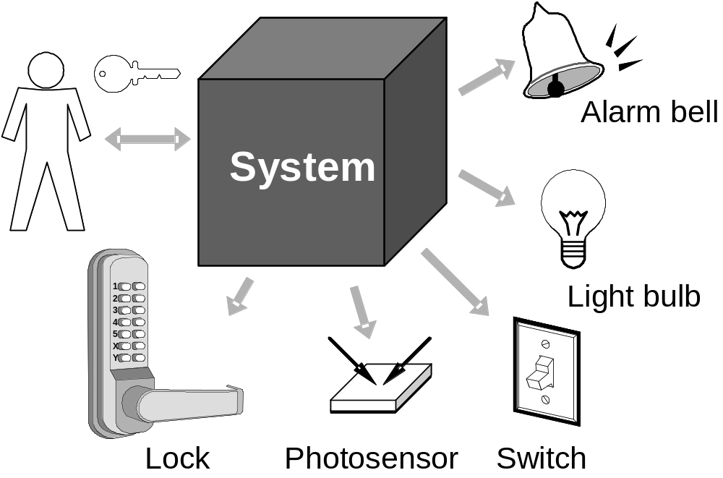
Case Study: Home Access Control
Objective: Design an electronic system for:
  Home access control
    Locks and lighting operation
  Intrusion detection and warning

Slide 40
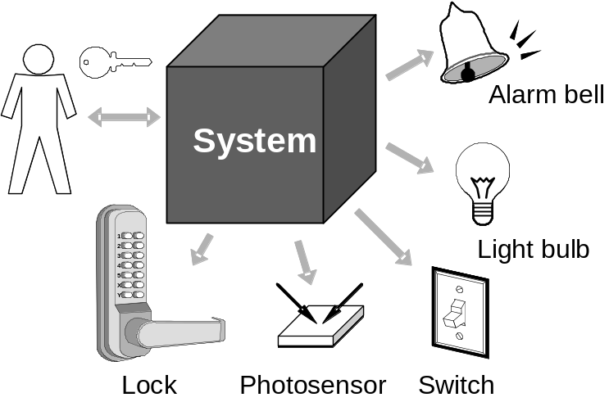
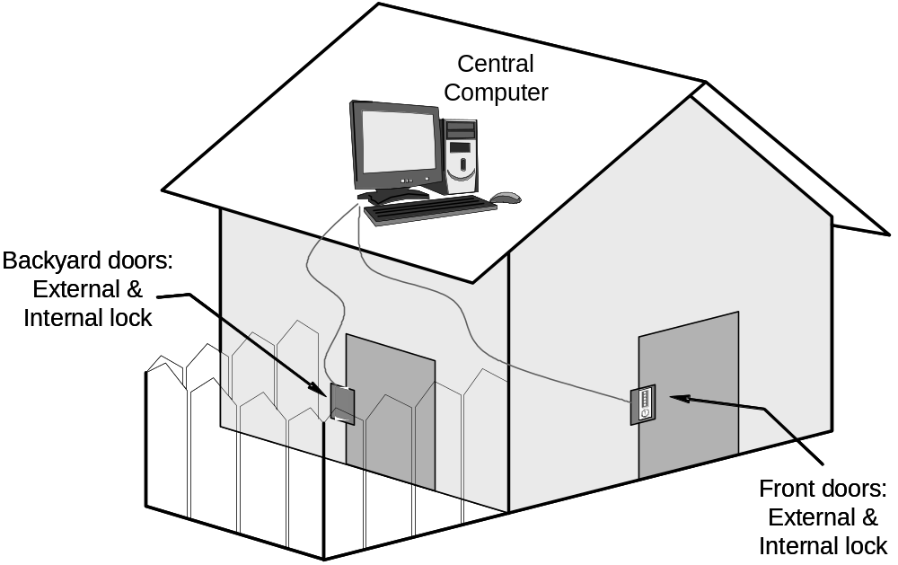
Case Study – More Details

Slide 41
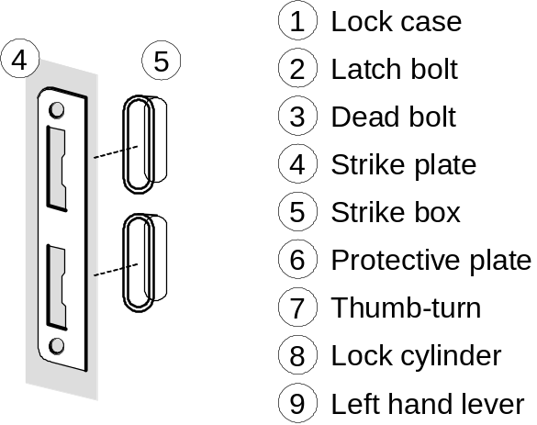
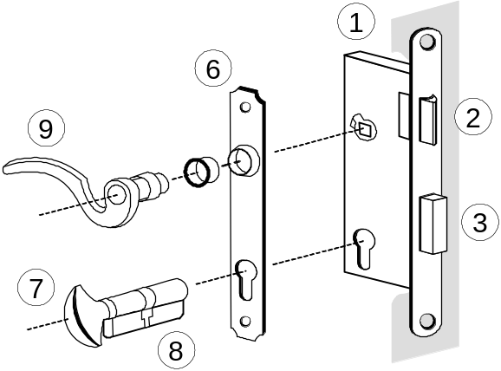
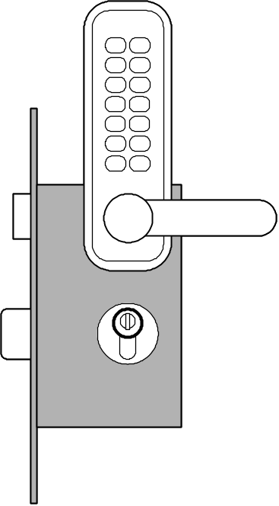
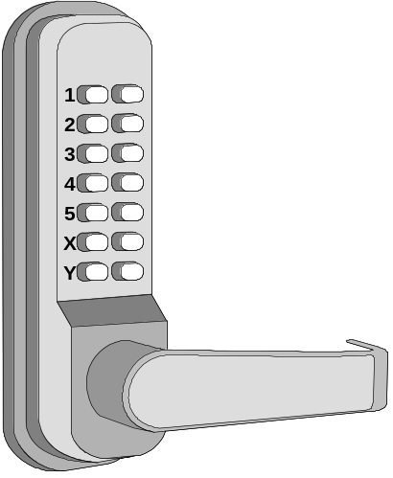
Know Your Problem
Mortise Lock Parts

Slide 42
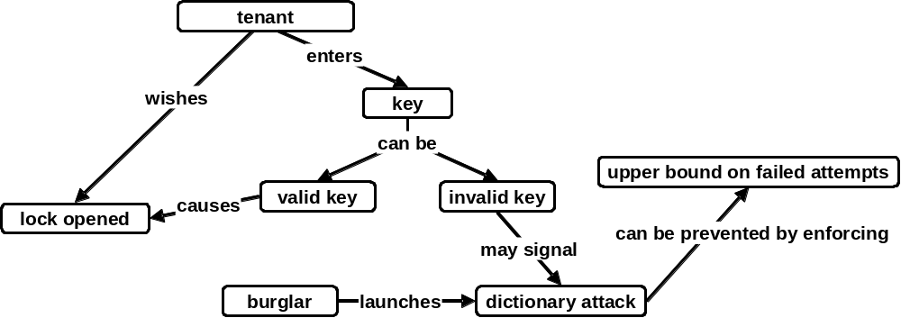
Concept Map for Home Access Control

Slide 43
States and Transition Rules
IF validKey AND holdOpenInterval THEN unlock
IF validKey THEN unlock
locked
unlocked
IF pushLockButton THEN lock
IF timeAfterUnlock ≥ max{ autoLockInterval, holdOpenInterval } THEN lock
… what seemed a simple problem, now is becoming complex

